Slide 1
HTML Tutorial-3
by
Samrat Sarkar

Slide 2
Images
Here you will learn about images and how to place images in your pages.

Slide 3
<IMG>This element defines a graphic image on the page.
Image File (SRC:source): This value will be a URL (location of the image) E.g. http://www.domain.com/dir/file.ext or /dir/file.txt.
Alternate Text (ALT): This is a text field that describes an alternate text for an image if the image cannot be displayed due to some issue.
Alignment (ALIGN): This allows you to align the image on your page.

Slide 4
Images
Width (WIDTH): is the width of the image in pixels.
Height (HEIGHT): is the height of the image in pixels.
Border (BORDER): is for a border around the image, specified in pixels.
HSPACE: is for Horizontal Space on both sides of the image specified in pixels. A setting of 5 will put 5 pixels of invisible space on both sides of the image.
VSPACE: is for Vertical Space on top and bottom of the image specified in pixels. A setting of 5 will put 5 pixels of invisible space above and bellow the image.

Slide 5
Some Examples on images
1) <IMG SRC=“jordan.gif“ border=4>
2) <IMG SRC=" jordan.gif" width="60" height="60">
3) <IMG SRC=“jordan.gif" ALT="This is a text that goes with the image">
4) <IMG SRC=" jordan.gif “ Hspace="30" Vspace="10" border=20>
5) < IMG SRC =" jordan.gif“ align="left">

Slide 6
Anchors, URLs and Image Maps
In this chapter you will learn about Uniform Resource Locator, and how to add them as Anchor or Links inside your web pages.
Objectives
Upon completing this section, you should be able to
Insert links into documents.
Define Link Types.
Define URL.
List some commonly used URLs.
Plan an Image Map.

Slide 7
HOW TO MAKE A LINK
1) The tags used to produce links are the <A>
and </A>. The <A> tells where the link should start and the </A> indicates where the link ends. Everything between these two will work as a link.
2) The example below shows how to make the word
Here work as a link to yahoo.
Click <A HREF="http://www.yahoo.com">here</A> to
go to yahoo.

Slide 8
Internal Links
Internal Links : Links can also be created inside large documents to simplify navigation. Today’s world wants to be able to get the information quickly. Internal links can help you meet these goals.
Select some text at a place in the document that you would like to create a link to, then add an anchor to link to like this:
<A NAME=“bookmark_name”></A>
The Name attribute of an anchor element specifies a location in the document that we link to shortly. All NAME attributes in a document must be unique.
Next select the text that you would like to create as a link to the location created above.
<A HREF=“#bookmark_name”>Go To Book Mark</A>

Slide 9
E-Mail (Electronic Mail)
E.g. mailto:kmf@yahoo.com
The type of service is identified as the mail client program. This type of link will launch the users mail client.
The recipient of the message is kmf@yahoo.com
<A HREF=“mailto:kmf@yahoo.com”>Send me
More Information </A>

Slide 10
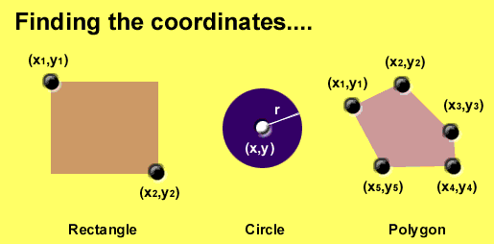
Area Shapes Used

Slide 11
Client-Side Image Maps
Client-side image maps (USEMAP) use a map file that is part of the HTML document (in an element called MAP), and is linked to the image by the Web browser.
<IMG SRC="note.GIF" Width=200 Height=200
border="5" USEMAP="#map1">
<MAP NAME="map1">
<AREA SHAPE="RECT" COORDS="0,0,90,90"
HREF="hi.html" ALT="see me…">
<AREA SHAPE="RECT" COORDS="100,100,160,160"
HREF="divPara.html" ALT="see him…" >
<AREA SHAPE="CIRCLE" COORDS="150,50,20"
HREF="house.html" ALT="see it…" >
</MAP>
We can use Poly as well as Rect……

Slide 12
Shapes, Coords
Types of Shapes
Rect → used for squares and ordered shapes.
Circle → used for circles.
Poly → used for unordered shapes.
Number of coordenations for each shape:
Rect →4 numbers for two corners
Circle →3 numbers for the center & R
Poly → depends on the number of corners of the shape( 2 numbers for each corner)

Slide 13
Tables
In this chapter you will learn that tables have many uses in
HTML.
Objectives:
Upon completing this section, you should be able to:
Insert a table.
Explain a table’s attributes.
Edit a table.
Add a table header.

Slide 14
Tables
The <TABLE></TABLE> element has four sub-elements:
Table Row<TR></TR>.
Table Header <TH></TH>.
Table Data <TD></TD>.
Caption <CAPTION></CAPTION>.
The table row elements usually contain table header elements or table data elements.

Slide 15
Tables
<table border=“1”>
<tr>
<th> Column 1 header </th>
<th> Column 2 header </th>
</tr>
<tr>
<td> Row1, Col1 </td>
<td> Row1, Col2 </td>
</tr>
<tr>
<td> Row2, Col1 </td>
<td> Row2, Col2 </td>
</tr>
</table>

Slide 16
Tables
Column 1 Header | Column 2 Header
Row1, Col1 | Row1, Col2
Row2, Col1 | Row2, Col2

Slide 17
Tables Attributes
BGColor: Some browsers support background colors in a table.
Width: you can specify the table width as an absolute number of pixels or a percentage of the document width. You can set the width for the table cells as well.
Border: You can choose a numerical value for the border width, which specifies the border in pixels.
CellSpacing: Cell Spacing represents the space between cells and is specified in pixels.

Slide 18
Table Attributes
CellPadding: Cell Padding is the space between the cell border and the cell contents and is specified in pixels.
Align: tables can have left, right, or center alignment.
Background: Background Image, will be titled in IE3.0 and above.
BorderColor, BorderColorDark.

Slide 19
Table Caption
A table caption allows you to specify a line of text that will appear centered above or bellow the table.
<TABLE BORDER=1 CELLPADDING=2>
<CAPTION ALIGN=“BOTTOM”> Label For My Table </CAPTION>
The Caption element has one attribute ALIGN that can be either TOP (Above the table) or BOTTOM (below the table).

Slide 20
Table Header
Table Data cells are represented by the TD element. Cells can also be TH (Table Header) elements which results in the contents of the table header cells appearing centered and in bold text.

Slide 21
Table Data and Table Header Attributes
Colspan: Specifies how many cell columns of the table this cell should span.
Rowspan: Specifies how many cell rows of the table this cell should span.
Align: cell data can have left, right, or center alignment.
Valign: cell data can have top, middle, or bottom alignment.
Width: you can specify the width as an absolute number of pixels or a percentage of the document width.
Height: You can specify the height as an absolute number of pixels or a percentage of the document height.

Slide 22
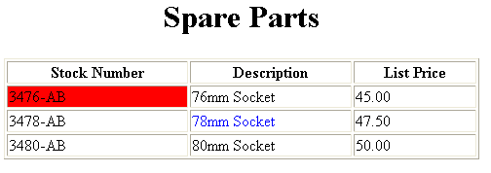
Basic Table Code
<TABLE BORDER=1 width=50%>
<CAPTION> <h1>Spare Parts <h1> </Caption>
<TR><TH>Stock Number</TH><TH>Description</TH><TH>List Price</TH></TR>
<TR><TD bgcolor=red>3476-AB</TD><TD>76mm Socket</TD><TD>45.00</TD></TR>
<TR><TD >3478-AB</TD><TD><font color=blue>78mm Socket</font> </TD><TD>47.50</TD></TR>
<TR><TD>3480-AB</TD><TD>80mm Socket</TD><TD>50.00</TD></TR>
</TABLE>

Slide 23
Table Data and Table Header Attributes
<Table border=1 cellpadding =2>
<tr> <th> Column 1 Header</th> <th> Column 2 Header</th> </tr>
<tr> <td colspan=2> Row 1 Col 1</td> </tr>
<tr> <td rowspan=2>Row 2 Col 1</td>
<td> Row 2 Col2</td> </tr>
<tr> <td> Row 3 Col2</td> </tr>
</table>

Slide 24
Table Data and Table Header Attributes
Column 1 Header | Column 2 Header
Row 1 Col 1
Row 2 Col 1 | Row 2 Col 2
 | Row 3 Col 2

Slide 25
What will be the output?
<TABLE BORDER width=“750”>
<TR> <TD colspan=“4” align=“center”>Page Banner</TD></TR>
<TR> <TD rowspan=“2” width=“25%”>Nav Links</TD><TD colspan=“2”>Feature Article</TD> <TD rowspan=“2” width=“25%”>Linked Ads</TD></TR>
<TR><TD width=“25%”>News Column 1 </TD> <TD width=“25%”><News Column 2 </TD></TR>
</TABLE>

Slide 26
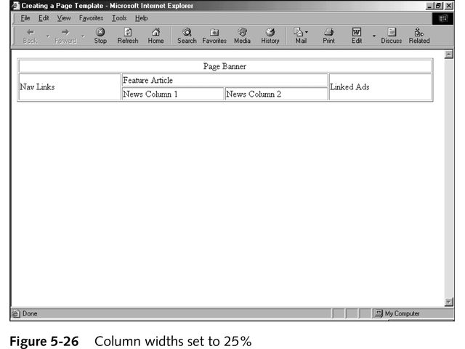
The Output

Slide 27
Frames
Frames are a relatively new addition to the HTML standard. First introduced in Netscape Navigator 2.0.
Objectives:
Upon completing this section, you should be able to:
Create a Frame based page.
Work with the Frameset, Frame, and Noframes elements.
Use the attributes of the Frames elements to control the display.
Set Targets appropriately.

Slide 28
Frames
A framed page is actually made up of multiple HTML pages. There is one HTML document that describes how to break up the single browser window into multiple windowpanes. Each windowpane is filled with an HTML document.
For Example to make a framed page with a windowpane on the left and one on the right requires three HTML pages. Doc1.html and Doc2.html are the pages that contain content. Frames.html is the page that describes the division of the single browser window into two windowpanes.

Slide 29
Frames
Doc1.html
Doc2.html
Doc1.html
Doc2.html
Frames.html

Slide 30
Frame Page Architecture
A <FRAMESET> element is placed in the html document before the <BODY> element. The <FRAMESET> describes the amount of screen given to each windowpane by dividing the screen into ROWS or COLS.
The <FRAMESET> will then contain <FRAME> elements, one per division of the browser window.
Note: Because there is no BODY container, FRAMESET pages can't have background images and background colors associated with them.

Slide 31
Frame Page Architecture
<HTML>
<HEAD>
<TITLE> Framed Page </TITLE>
<FRAMESET COLS=“23%,77%”>
<FRAME SRC=“Doc1.html”>
<FRAME SRC=“Doc2.html”>
</FRAMESET >
</HEAD>
</HTML>

Slide 32
The Diagram below is a graphical view of the document described above
FRAMESET COLS=”23%, 77%”
FRAME
NAME= left_pane
SRC=Doc1.html
FRAME
NAME=right_pane
SRC= Doc2.html

Slide 33
<FRAMESET> Container
<FRAMESET> : The FRAMESET element creates divisions in the browser window in a single direction. This allows you to define divisions as either rows or columns.
ROWS : Determines the size and number of rectangular rows within a <FRAMESET>. They are set from top of the display area to the bottom.
Possible values are:
Absolute pixel units, I.e. “360,120”.
A percentage of screen height, e.g. “75%,25%”.
Proportional values using the asterisk (*). This is often combined with a value in pixels , e.g. “360,*”.
<Frameset cols=“200,20%,*,2*”>

Slide 34
Creating a Frames Page
COLS: Determines the size and number of rectangular columns within a <FRAMESET>. They are set from left to right of the display area.
Possible values are:
Absolute pixel units, I.e. “480,160”.
A percentage of screen width, e.g. “75%,25%”.
Proportional values using the asterisk (*). This is often combined with a value in pixels , e.g. “480,*”.

Slide 35
Creating a Frames Page
FRAMEBORDER : Possible values 0, 1, YES, NO. A setting of zero will create a borderless frame.
FRAMESPACING: This attribute is specified in pixels. If you go to borderless frames you will need to set this value to zero as well, or you will have a gap between your frames where the border used to be.
BORDER(thickness of the Frame): This attribute specified in pixels. A setting of zero will create a borderless frame. Default value is 5.
BORDERCOLOR: This attribute is allows you choose a color for your border. This attribute is rarely used.

Slide 36
<FRAME>
<FRAME>: This element defines a single frame within a frameset. There will be a FRAME element for each division created by the FRAMESET element. This tag has the following attributes:
SRC: Required, as it provides the URL for the page that will be displayed in the frame.
NAME: Required for frames that will allow targeting by other HTML documents. Works in conjunction with the target attribute of the <A>, <AREA>, <BASE>, and <FORM> tags.

Slide 37
<FRAME>
MARGINWIDTH: Optional attribute stated in pixels. Determines horizontal space between the <FRAME> contents and the frame’s borders.
MARGINHEIGHT: Optional attribute stated in pixels. Determines vertical space between the <FRAME> contents and the frame’s borders.
SCROLLING: Displays a scroll bar(s) in the frame. Possible values are:
Yes – always display scroll bar(s).
No – never display scroll bar(s).
Auto – browser will decide based on frame contents.
By default: scrolling is auto.

Slide 38
<FRAME>
NORESIZE: Optional – prevents viewers from resizing the frame. By default the user can stretch or shrink the frame’s display by selecting the frame’s border and moving it up, down, left, or right.

Slide 39
<NOFRAMES>
<NOFRAMES>: Frame – capable browsers ignore all HTML within this tag including the contents of the BODY element. This element does not have any attributes.
<HTML>
<HEAD>
<TITLE> Framed Page </TITLE>
</HEAD>

Slide 40
<NOFRAMES>
<FRAMESET COLS="23%,77%">
<FRAME SRC="" NAME="left_pane“>
<FRAME SRC="" NAME="right_pane">
<NOFRAMES>
<P> This is a Framed Page. Upgrade your browser to support frames.</P>
</NOFRAMES></FRAMESET>

Slide 41
Compound FRAMESET Divisions
In this case a second FRAMESET element will be inserted in the place of the FRAME element that would describe the second row.
The second FRAMESET element will divide the remaining screen into 2 columns.
This nested FRAMESET will then be followed by 2 FRAME elements to describe each of the subsequent frame divisions created.

Slide 42
Compound FRAMESET Divisions
<html>
<head>
<title> Compound Frames Page</title>
</head>
<frameset rows=“120,*”>
<frame src=“banner_file.html” name=”banner”>
<frameset cols=“120,*”>
<frame src=“links_file.html” name=“links”>
<frame src=“content_file.html” name=“content”>
<noframes>
<p>
Default message
</p>
</noframes>
</frameset>
</frameset>
</head>

Slide 43
Compound FRAMESET Divisions You may want to create a frames design with a combination of rows and columns.
Banner File
Links
File
Contents File

Slide 44
Compound FRAMESET Divisions Example
<HEAD>
<FRAMESET ROWS="25%,50%,25%”
<FRAME SRC="">
<FRAMESET COLS="25%,*">
<FRAME SRC="">
<FRAME SRC="">
</FRAMESET>
<FRAME SRC="">
</FRAMESET>
</HEAD>

Slide 45
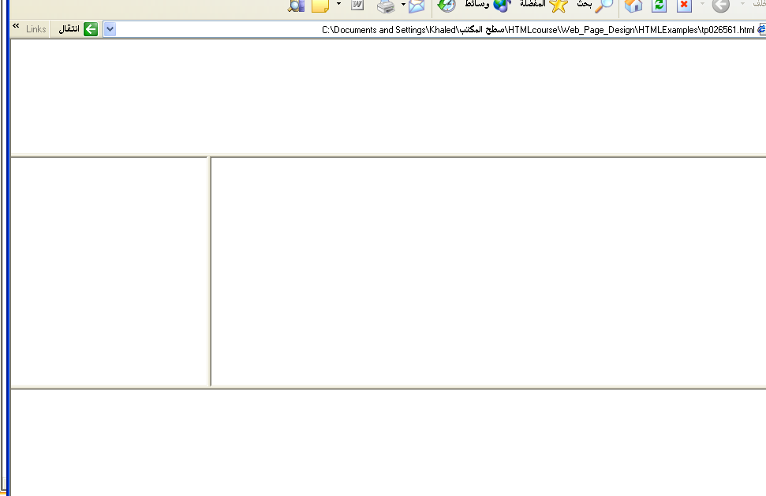
Output

Slide 46
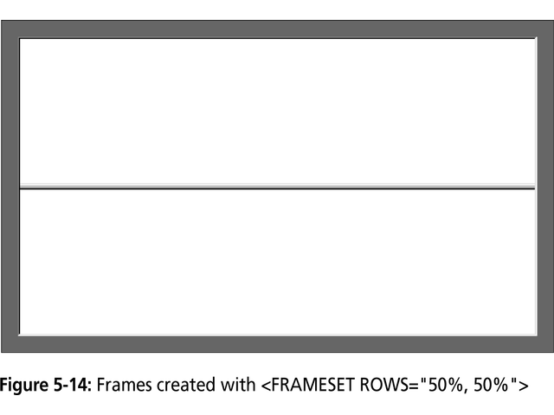

Slide 47
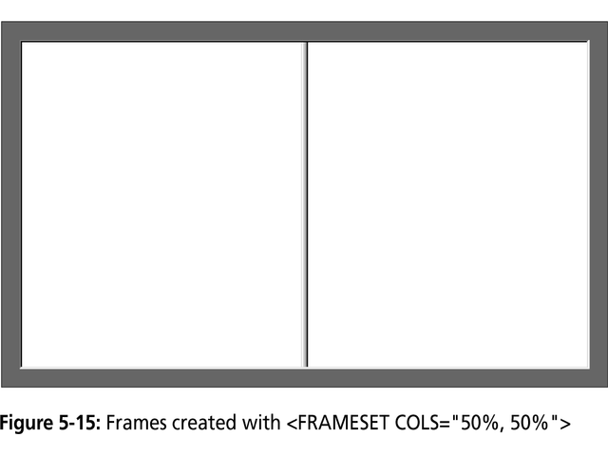

Slide 48
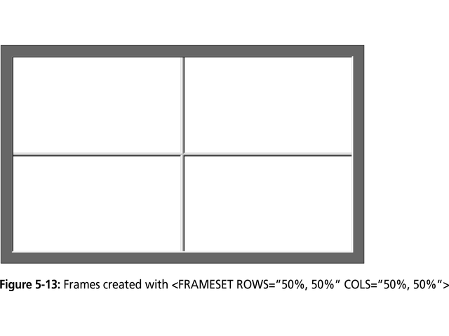

Slide 49
Frame Formatting
Example:
<frameset rows=“20%, *, 20%”>
<frame src=“header.html” noresize scrolling=no>
<frame src=“body.html”>
<frame src=“navigationbar.html” noresize scrolling=no>
</frameset>

Slide 50
What do the following mean?
<FRAMESET COLS="2*, 3*, 5*">
2) <FRAMESET COLS="150, 20%, *, 3*">
So what are the space-allocation priorities? Absolute pixel values are always assigned space first, in order from left to right. These are followed by percentage values of the total space. Finally, proportional values are divided based upon what space is left.

Slide 51
Generic Frame Formula
The <FRAME> tag has six associated attributes: SRC, NAME, MARGINWIDTH, MARGINHEIGHT, SCROLLING, and NORESIZE. Here's a complete generic FRAME:
<FRAME SRC="url" NAME="window_name" SCROLLING=YES|NO|AUTO MARGINWIDTH="value" MARGINHEIGHT="value"
NORESIZE>

Slide 52
What will be the Output?
<FRAMESET ROWS="*, 2*, *" COLS="2*, *">
<FRAME SRC=“”>
<FRAME SRC=“”>
<FRAME SRC=“”>
<FRAME SRC=“”>
<FRAME SRC=“”>
<FRAME SRC=“”>
</FRAMESET>

Slide 53
Targets
When you use links for use in a frames environment you will need to specify an additional attribute called TARGET.
The TARGET attribute uses the NAME attribute of the FRAME element.
If we were to place a link in doc1.html that linked to doc3.html and we wanted doc3.html to be displayed in the right windowpane; the HTML code would appear in doc1.html as follows:
<A HREF=“doc3.html” TARGET=“right_pane”>Link to Document 3 </A>

Slide 54
Special Targets
There are 4 special target names that cannot be assigned by the NAME attribute of the FRAME tag.
1. TARGET=“_top” : This loads the linked document into the full browser window with the URL specified by the HREF attribute. All frames disappear, leaving the new linked page to occupy the entire window. The back is turned on.
2. TARGET=“_blank” : Opens an unnamed new browser window and loads the document specified in the URL attribute into the new window (and your old window stays open). The back is turned off. Other windows remains on.
3. TARGET=“_self” : Loads the document in the same window where the anchor was {Clicked}. This is the default setting for linking elements.
4. TARGET=“_parent” : the _parent frame is a prior frameset that the current frameset was “spawned” from. If there isn’t one it is the browser window. The document is loaded into the area occupied by the columns or rows frameset containing the frame that contains the link. The back is turned on. All windows disappear.

Slide 55
If a frame contains the following link, then clicking the link launches a new, unnamed browser display window that contains the content defined in stuff.HTM. This can be a simple HTML document, or an entirely new FRAMESET definition.
1. <A HREF="stuff.html" TARGET="_blank">
If a frame contains the given link, then clicking the link will simply cause the frame which contains the link to clear, and its content will be replaced with whatever is in stuff.htm.
2. <A HREF="stuff.html" TARGET="_self">
If a frame contains the given link, the frameset which contains the frame that contains this link will be replaced by stuff.HTM.
3. <A HREF="stuff.html" TARGET="_parent">
Finally, if a frame contains the given link, clicking the link replaces the entire browser window with the contents of stuff.HTM.

Slide 56
Targeting links to frames
The TARGET attribute allows you to specify the frame into which a page is to be loaded into in a frames setting.
<A HREF=“chap1.html” TARGET=“_self”> [Chapter 1]</A>
<A HREF=“chap1.html” TARGET=“_parent”> [Chapter 2]</A>
Parent window
chap1.html
Learning HTML
[Chapter 1][Chapter 2][Chapter 3]
chap2.html

Slide 57
Targeting links to frames
The TARGET attribute allows you to specify the frame into which a page is to be loaded into in a frames setting.
<A HREF=“chap1.html” TARGET=“bottom”> [Chapter 1]</A>
<A HREF=“chap2.html” TARGET=“bottom”> [Chapter 2]</A>
<A HREF=“chap3.html” TARGET=“bottom”> [Chapter 3]</A>
chap1.html
Learning HTML
[Chapter 1][Chapter 2][Chapter 3]
chap2.html
chap3.html

